Slide 1
NLP & Deep Learning (Transformers)
Attention is all what you need

Slide 2
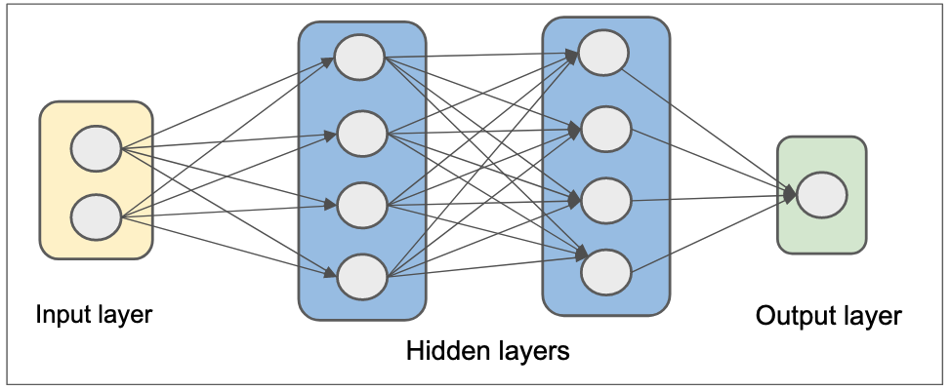
MLP

Slide 3
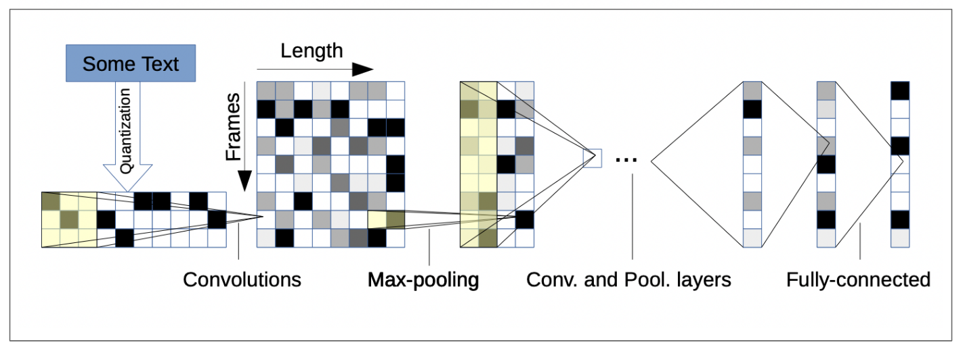
CNN

Slide 4
RNNs
RNNs are a type of neural network designed for sequential data, such as time series or natural language.
They have loops in their architecture, allowing information to persist. This means they can use previous inputs to influence the current output.
RNNs process sequences one element at a time, maintaining a hidden state that captures information about previous elements.
For example, in a sentence, the RNN would take one word, update its hidden state, and then take the next word, continuing this process.

Slide 5
RNN Architecture
Input: w1 → w2 → w3 → ... → wn
↓ ↓ ↓
[RNN] → [RNN] → [RNN]
↑ ↑ ↑
Output: y1, y2, y3, ..., yn

Slide 6
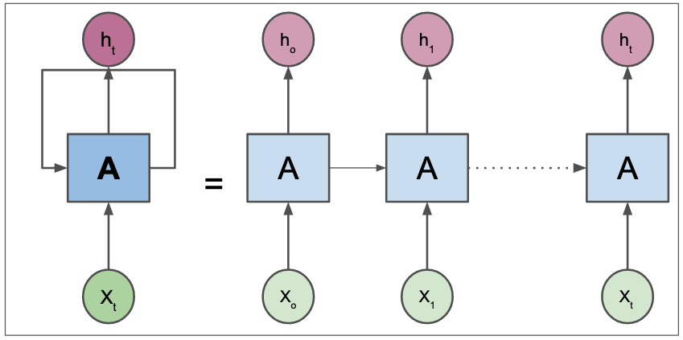
RNN

Slide 7
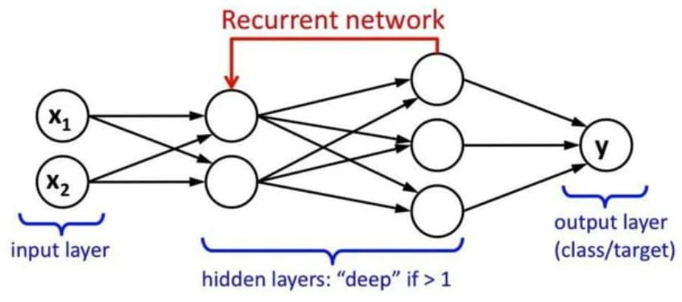

Slide 8
Limitations of RNNs
Vanishing Gradient Problem: As sequences get longer, the gradients used for training can become very small, making it hard for the network to learn long-range dependencies.
Sequential Processing: RNNs process data sequentially, which can be slow and inefficient, especially for long sequences.

Slide 9
Encoder-Decoder Architecture
This architecture is commonly used for tasks like machine translation.
It consists of two main components: the encoder, which processes the input sequence, and the decoder, which generates the output sequence.
The encoder takes the entire input sequence and compresses it into a fixed-size context vector (a summary of the input).
The decoder then takes this context vector and generates the output sequence, one element at a time.

Slide 10
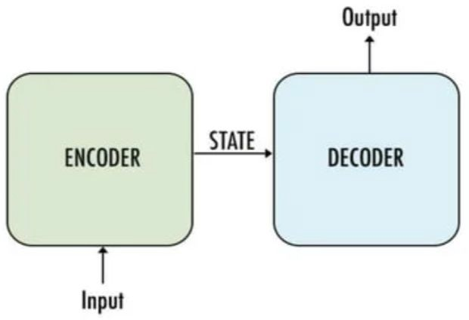
Encoder-Decoder Architecture
Input Sequence: w1 → w2 → w3 → ... → wn
↓
[Encoder]
↓
Context Vector (C)
↓
[Decoder]
↓
Output Sequence: y1 → y2 → y3 → ... → ym

Slide 11
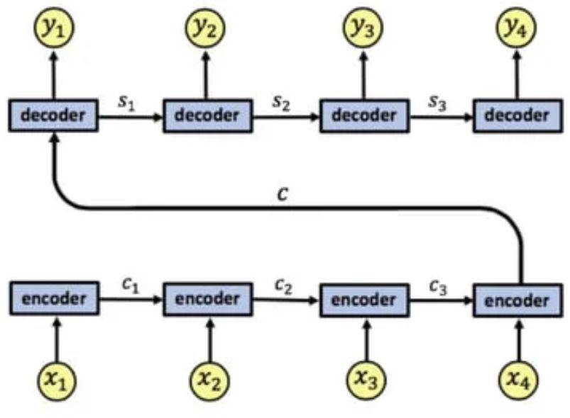
Encoder-Decoder Architecture

Slide 12
Limitations of Encoder-Decoder
The fixed-size context vector can be a bottleneck, especially for long input sequences, as it may not capture all necessary information.
Like RNNs, this architecture also suffers from the vanishing gradient problem.

Slide 13
Transformers
Transformers are a type of neural network architecture introduced in the paper "Attention is All You Need" by Vaswani et al. in 2017.
They are designed to handle sequential data but do not rely on recurrence.

Slide 14
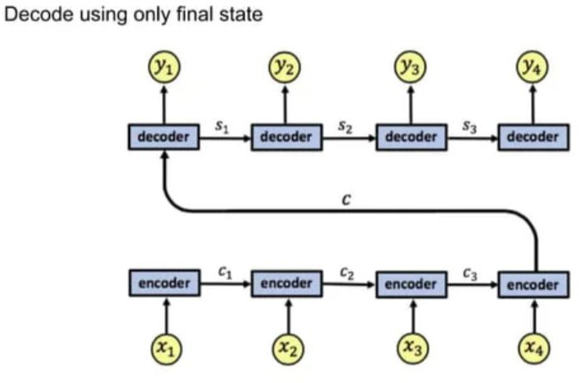
Without attention

Slide 15
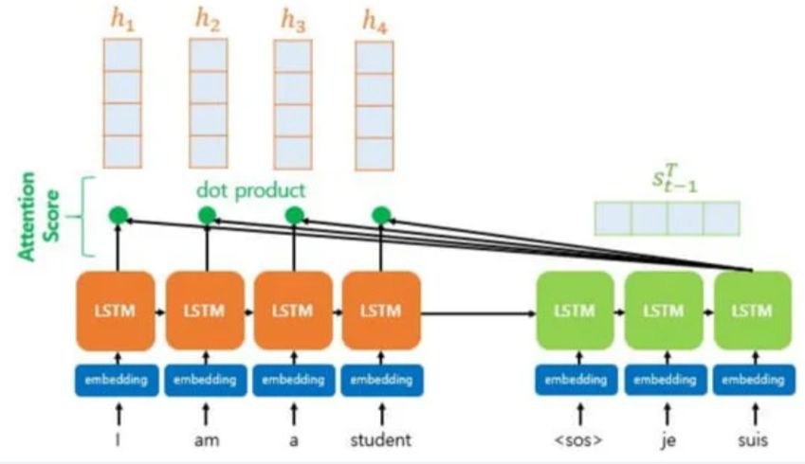
Attention

Slide 16
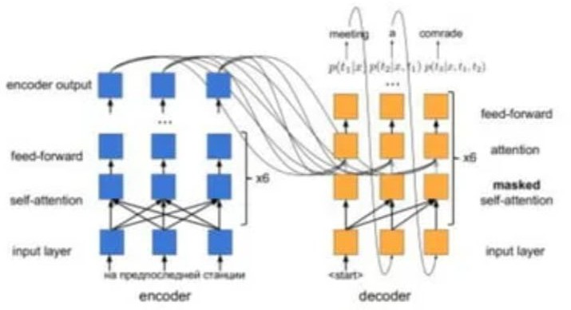
Attention - Transformer

Slide 17
Key Components of Transformers
Self-Attention Mechanism: This allows the model to weigh the importance of different words in a sequence when encoding them. Each word can attend to every other word, capturing relationships regardless of their distance in the sequence.
Positional Encoding: Since transformers do not process data sequentially, they use positional encodings to give the model information about the position of each word in the sequence.
Multi-Head Attention: This allows the model to focus on different parts of the sequence simultaneously, enhancing its ability to capture complex relationships.
Feed-Forward Neural Networks: After the attention mechanism, the output is passed through feed-forward networks for further processing.

Slide 18
Transformer Architecture
Input Sequence: w1 → w2 → w3 → ... → wn
↓
[Positional Encoding]
↓
[Multi-Head Attention]
↓
[Add & Norm]
↓
[Feed-Forward Network]
↓
[Add & Norm]
↓
Output Sequence: y1 → y2 → y3 → ... → ym

Slide 19
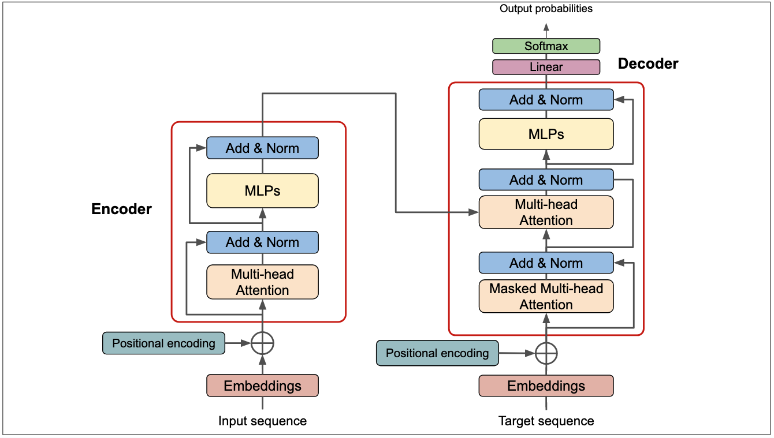
Transformer

Slide 20
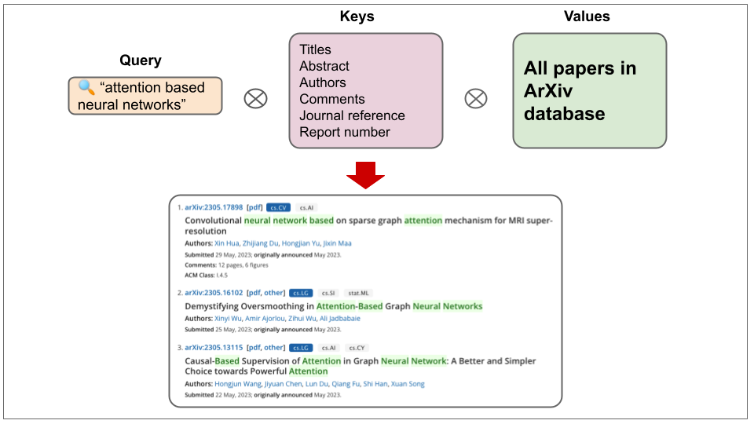
Attention Function: Query, Key, Value

Slide 21
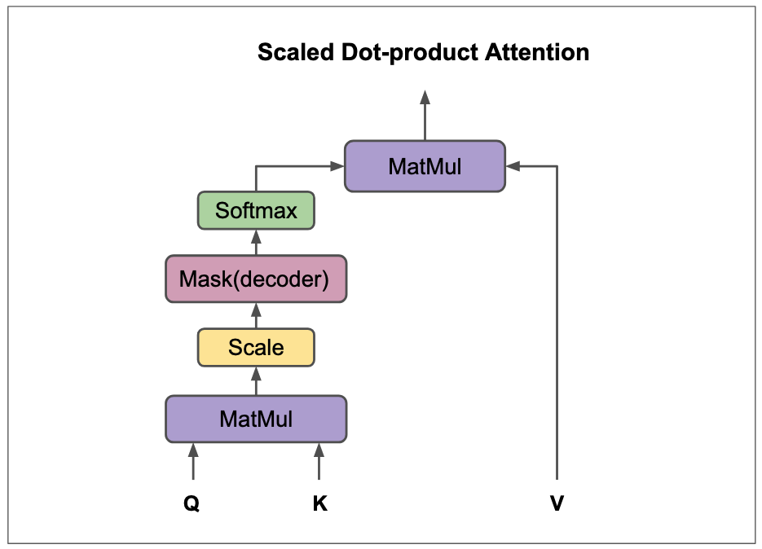

Slide 22
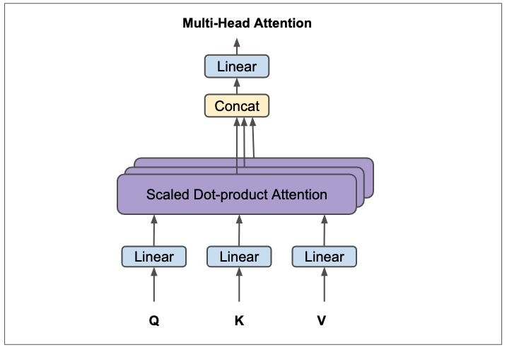

Slide 23
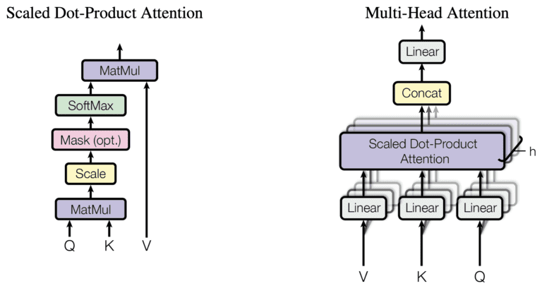
Implementation

Slide 24
Types of Attentions
Attention Type | Description | Use Cases
Self-Attention | Each word attends to all others in the sequence, including itself. | Used in both encoder and decoder (e.g., BERT, GPT).
Scaled Dot-Product Attention | Dot-products scaled by the square root of the query dimension to prevent large gradients. | Standard in multi-head attention.
Multi-Head Attention | Parallel self-attention layers to capture different context features. | Core of transformer models.
Cross-Attention | Queries from one sequence attend to another (e.g., decoder attending to encoder outputs). | Used in machine translation.
Sparse Attention | Focuses only on a subset of tokens to reduce computation. | Long-sequence models (e.g., Longformer).
Global Attention | Certain tokens access the entire sequence, while others attend locally. | Mixed context models (e.g., Longformer).
Linearized Attention | Approximates full attention with linear complexity. | Efficient for long sequences (e.g., Linformer).
Memory-Augmented Attention | Uses external memory to store past representations for long-term dependencies. | Long-term memory tasks (e.g., Transformer-XL).

Slide 25
Advantages of Transformers
Parallelization: Unlike RNNs, transformers can process all words in a sequence simultaneously, making them much faster and more efficient.
Long-Range Dependencies: The self-attention mechanism allows transformers to capture long-range dependencies effectively, overcoming the limitations of RNNs and fixed-size context vectors.

Slide 26
Self-Attention Mechanism
Input: w1 w2 w3
| | |
↓ ↓ ↓
Attention Scores:
w1 → [0.1, 0.7, 0.2]
w2 → [0.3, 0.4, 0.3]
w3 → [0.5, 0.2, 0.3]

Slide 27
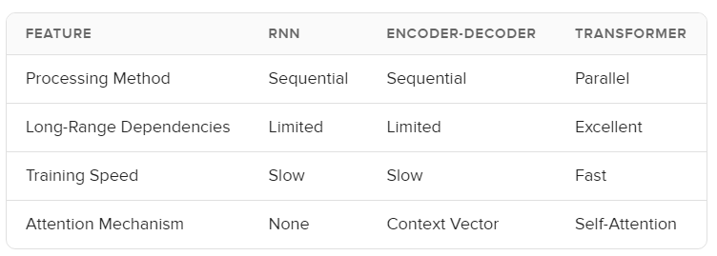
Comparison

Slide 28
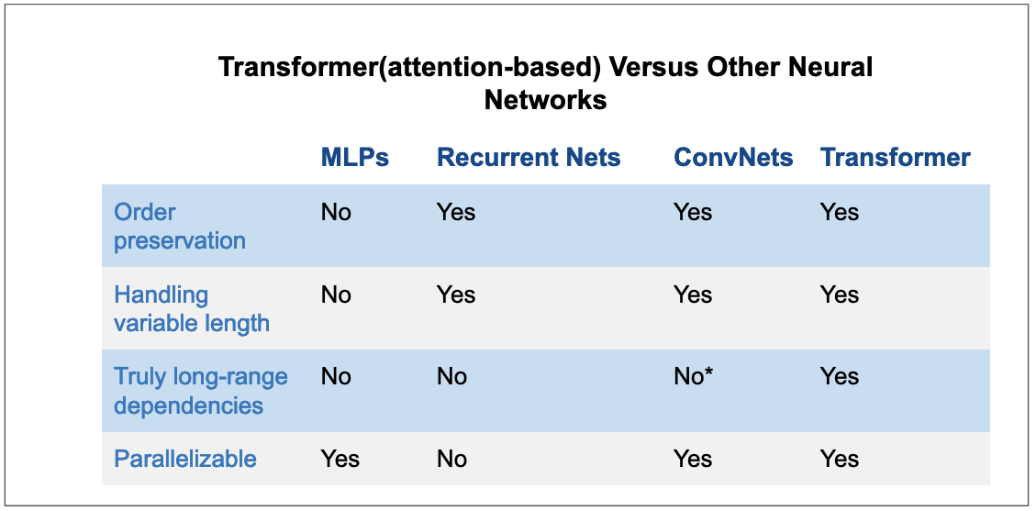

Slide 29
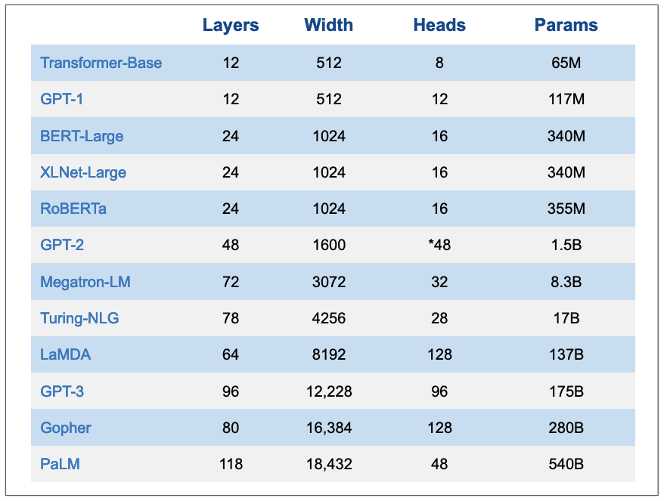

Slide 30
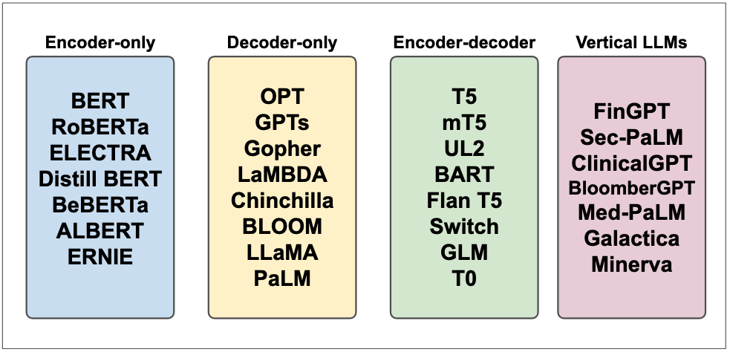
Notes:
Vertical LLMs
Most of LLMs that we outlined above are typically referred to as foundational or frontier LLMs. Foundational models are typically trained on massive amount of data with self-supervision and they can be fine-tuned to a wide range of downstream tasks(Bommasani et al. 2022).
Vertical LLMs are a class of LLMs that are adapted to specific applications. Foundational LLMs can generalize to simple tasks like sentiment analysis but they don’t perform well on complex tasks or tasks that require a domain expertize. For example, a foundational LLM is unlikely to perform well on medical question answering task because it doesn’t have expertize in medicine. More examples: a foundational LLM is unlikely to perform well on legal question answering task because it doesn’t have expertize in law. This is also true in other fields such as finance, physics, chemistry, etc…Vertical LLMs are designed to address this issue. They are trained on a specific domain and they can perform well on tasks that require expertize in that domain. Foundational models aim to be generalists but most of the time, we care about models that can do one thing very well.

Slide 31
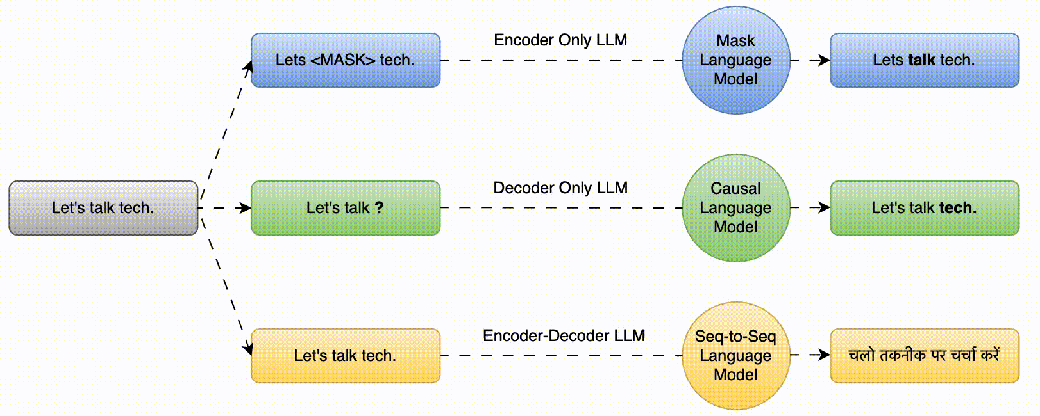

Slide 32
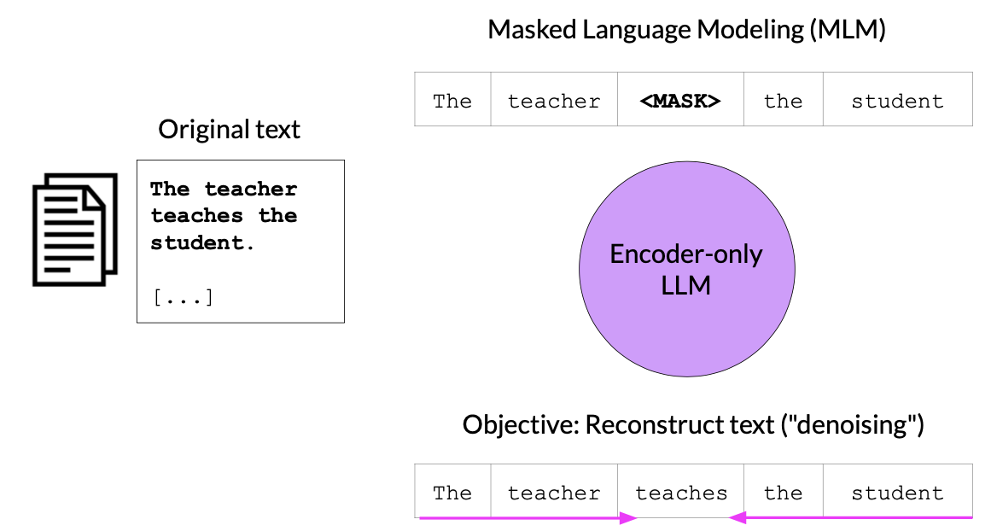
Encoder Models
Usecases : Sentiment Analysis, Named Entity Classification, etc.
Model Ex. : BERT, RoBERTa, etc

Slide 33
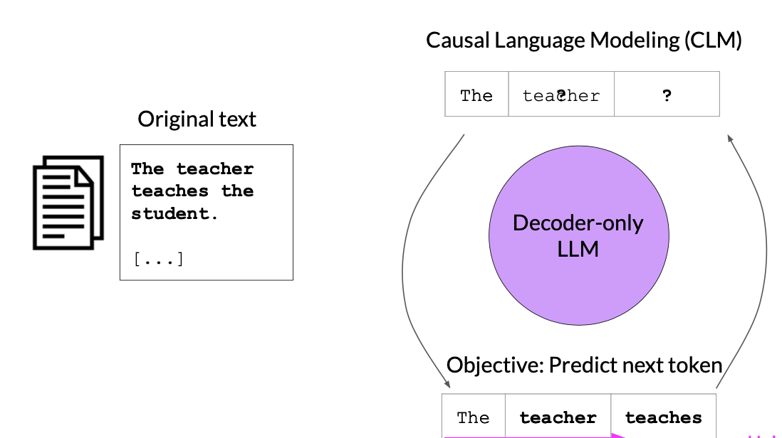
Decoder Models
Usecases : Text Generation, etc
Model Ex : GPT, BLOOM, etc

Slide 34
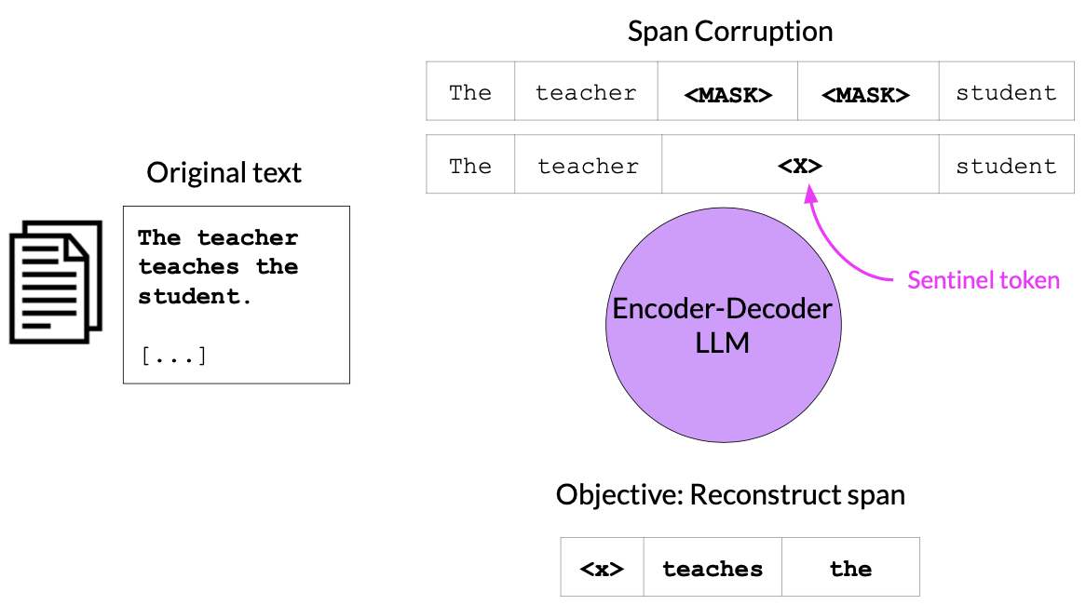
Encoder-Decoder Models
Usecases : Translation, Text Summarization, Question & Answering etc.
Model Ex : T5, BART, etc

Slide 35
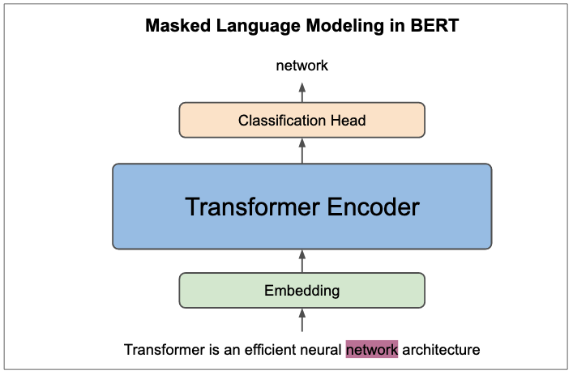
BERT (Bidirectional Encoder Representations from Transformers)

Slide 36
What is BERT
BERT is a method of pre-training language representations, meaning it is a general-purpose model trained on a large text corpus (e.g., Wikipedia). This pre-trained model is then used for downstream NLP tasks such as question answering.
BERT is the first unsupervised, deeply bidirectional system for pre-training NLP.
Unsupervised here means that BERT was trained using only a plaintext corpus (no labeled data), which is important because there is an enormous amount of publicly available plain text data in many languages on the web.

Slide 37
BERT
- BERT (Bidirectional Encoder Representations from Transformers):
- A language model developed by **Google** in **2018** that significantly improved performance in **Natural Language Processing (NLP)**.
- The BERT method was adapted to the **French language** in **2019** with two models:
1. CamemBERT: Pre-trained on a corpus of **138 GB** of text.
2. FlauBERT: Pre-trained on a corpus of **71 GB** of text.

Slide 38
BERT
BERT has also been adapted for the Italian language with models similar to CamemBERT and FlauBERT, aimed at enhancing performance for Italian-specific Natural Language Processing (NLP) tasks. Two of the prominent models are:
AlBERTo: Developed by the Digital Humanities research group at the University of Bari Aldo Moro, this model is pre-trained on Italian social media data (tweets) and is specifically tuned for sentiment analysis and other tasks involving informal text.
Italian BERT (GilBERTo): This version of BERT is pre-trained on a large Italian corpus from various sources, such as news articles, Wikipedia, and legal texts. It performs well across multiple NLP tasks in Italian.
Both models are fine-tuned for Italian text, helping to improve tasks such as text classification, named entity recognition (NER), and question-answering in Italian.

Slide 39
BERT masked language modeling (MLM)
Contextualization: each word is contextualized by the words to its left (or right). This indicates that the model processes the sentence in both directions to understand the meaning of words.
Masking: About 15% of the words in the input sequence are randomly masked, represented by placeholders like [MASK1] and [MASK2]. The model then tries to predict what the masked words are based on the context provided by the surrounding words.
Deep Bidirectional Transformer Encoder: The input sequence is fed into a bidirectional Transformer encoder, which processes the words in both directions (left-to-right and right-to-left) to capture contextual information. After this, the model predicts the masked words.
Example:
Input: "the man went to the [MASK1] . he bought a [MASK2] of milk."
Labels (the correct words for the masked tokens): [MASK1] = store, [MASK2] = gallon.
This approach is used for training language models to better understand context and relationships between words in a sentence

Slide 40
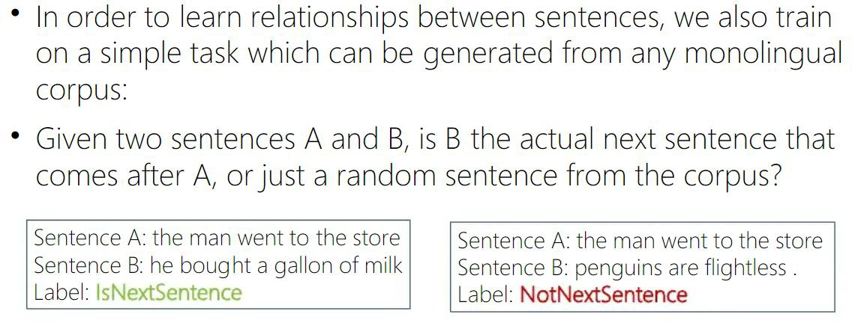
BERT

Slide 41
(Text-to-Text Transfer Transformer)
T5

Slide 42
T5
T5 is an encoder-decoder model pre-trained on a multi-task mixture of unsupervised and supervised tasks and for which each task is converted into a text-to-text format.
T5 works well on a variety of tasks out-of-the-box by prepending a different prefix to the input corresponding to each task.
Example:
for translation: translate English to German: ...,
for summarization: summarize: ....

Slide 43
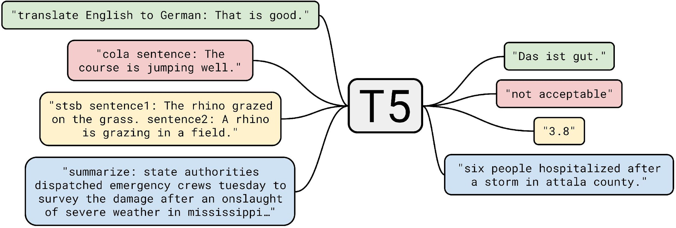
T5 (Text-to-Text Transfer Transformer)

Slide 44
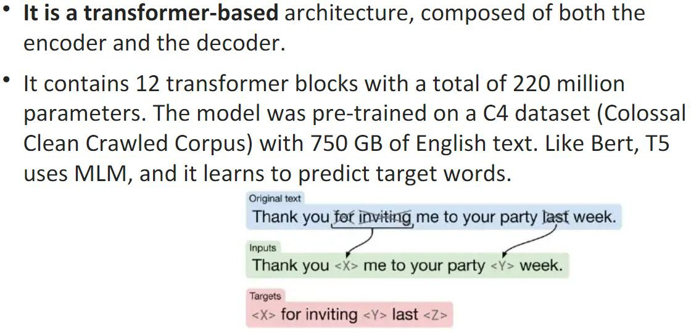
T5

Slide 45
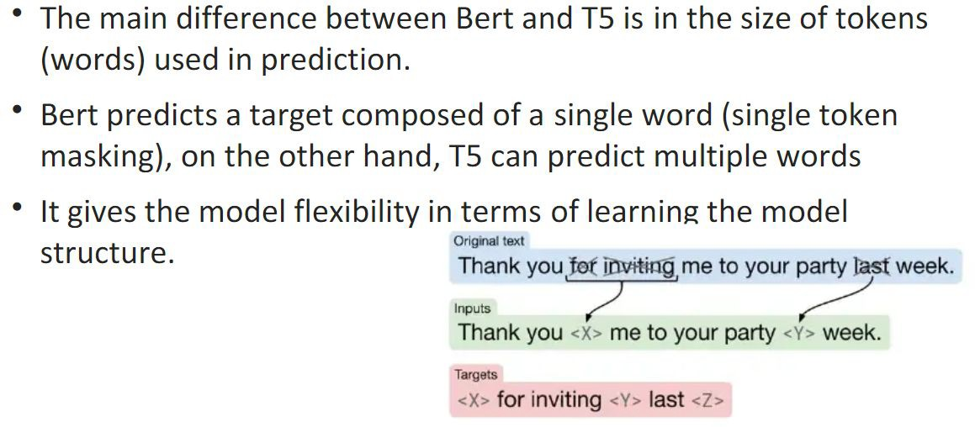
T5 vs BERT

Slide 46
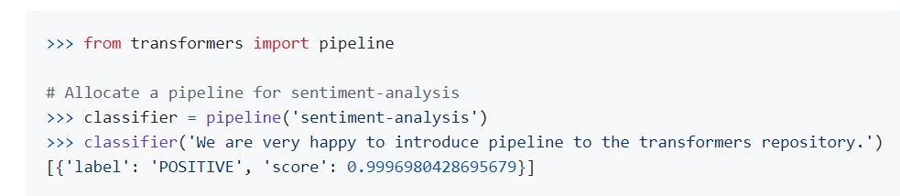
How to use transformers

Slide 47
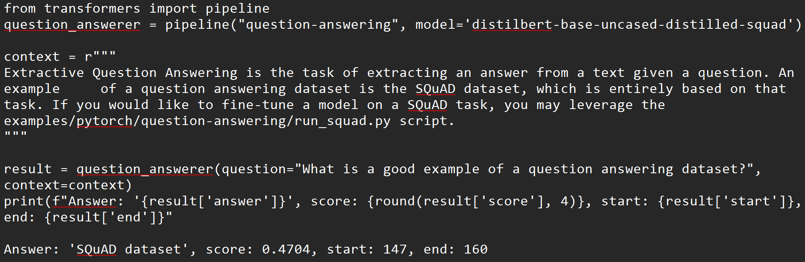
How to use transformers

Slide 48


QA

Slide 49
GANs

Slide 50
GANs
Generative Adversarial Networks (GANs) are a class of machine learning frameworks introduced by Ian Goodfellow and his colleagues in 2014.
GANs consist of two neural networks, called the generator and the discriminator, which are pitted against each other in a process known as adversarial training.

Slide 51
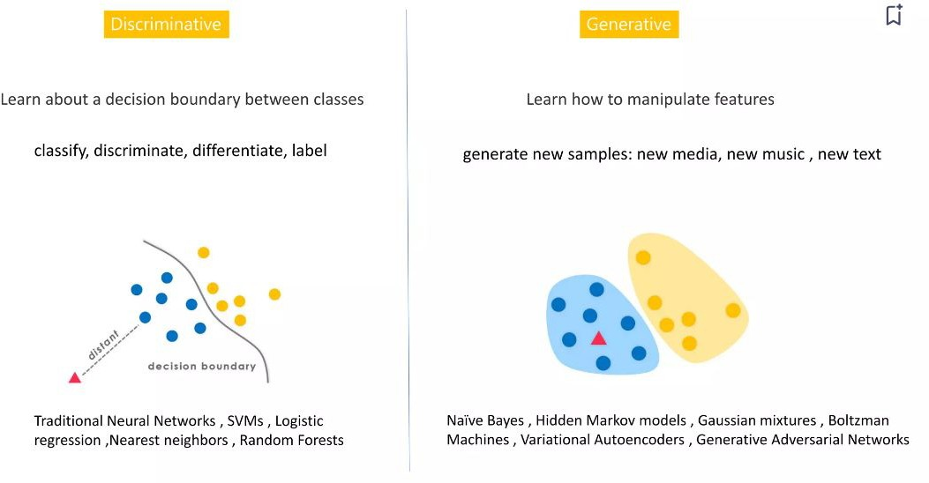
Discriminative vs Generative

Slide 52
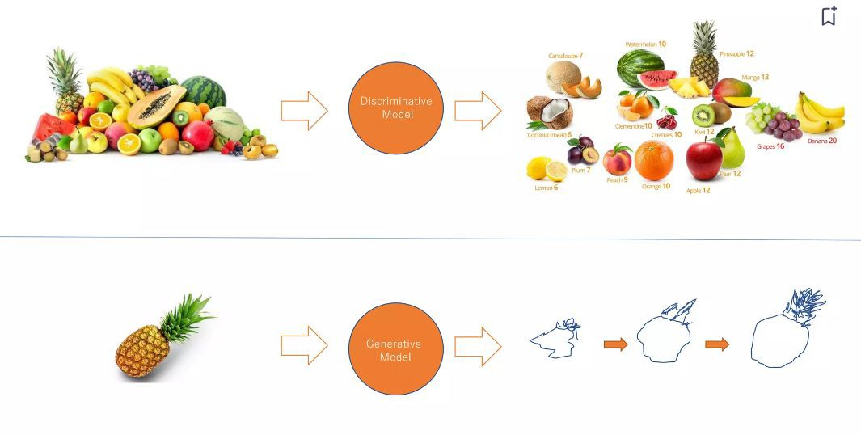
Discriminative vs Generative

Slide 53
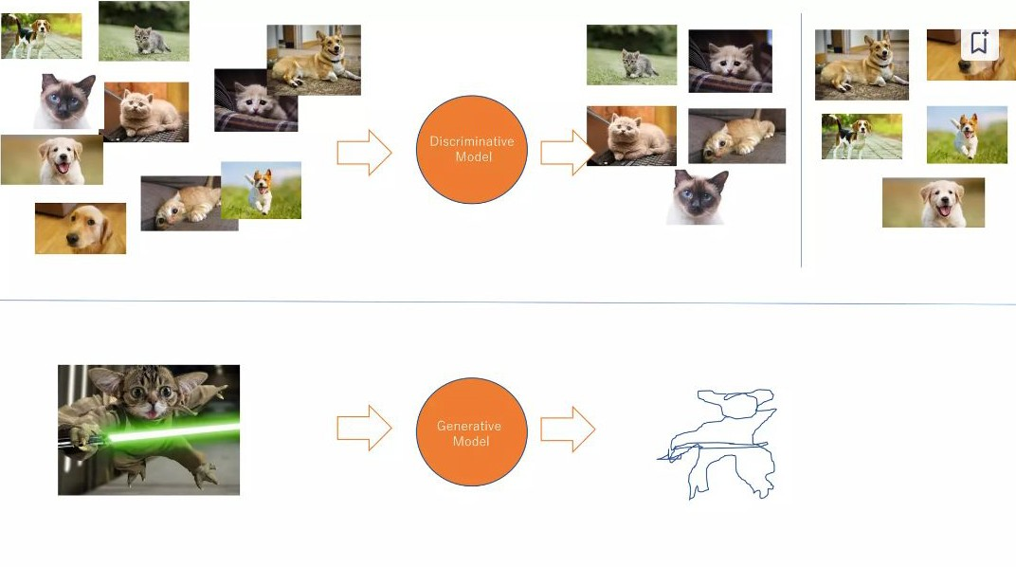
Discriminative vs Generative

Slide 54
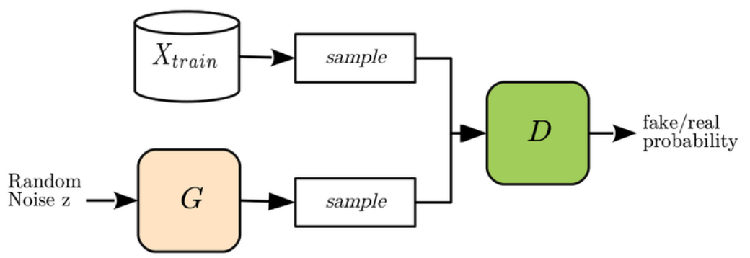
GANs Architecture

Slide 55
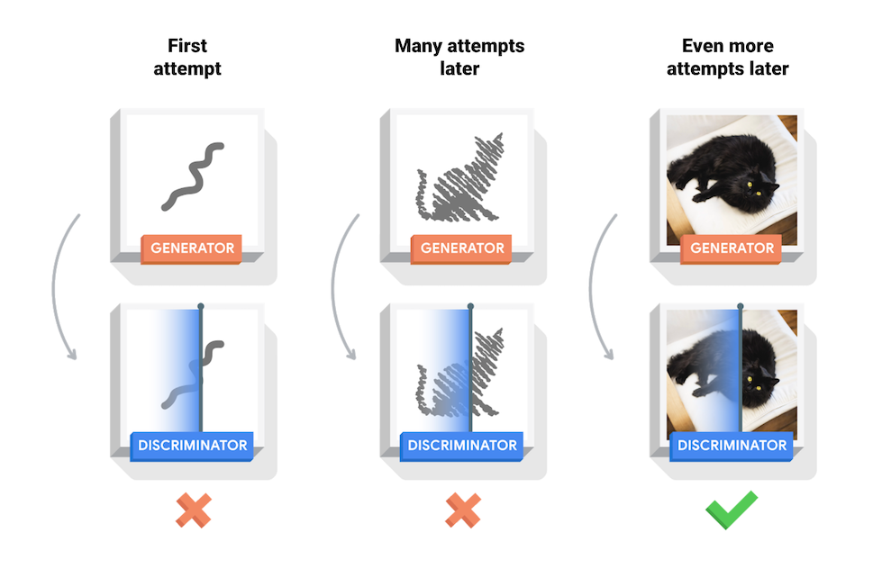

Slide 56
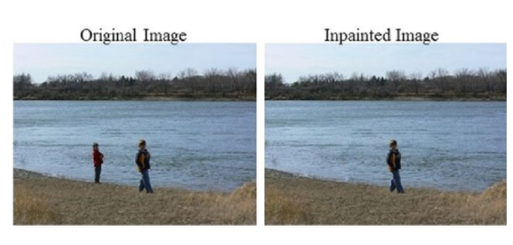
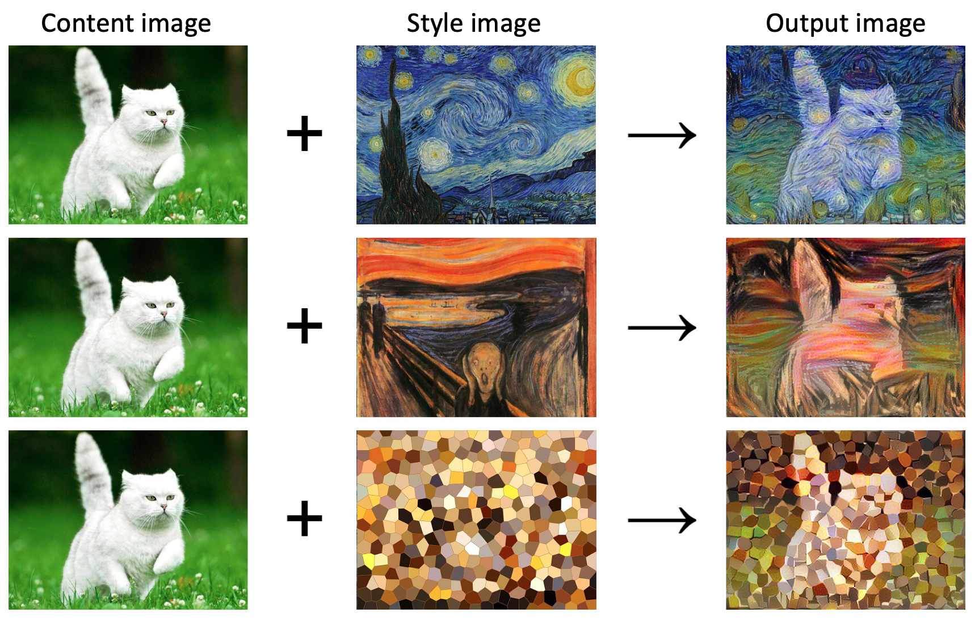
GANs Applications

Slide 57
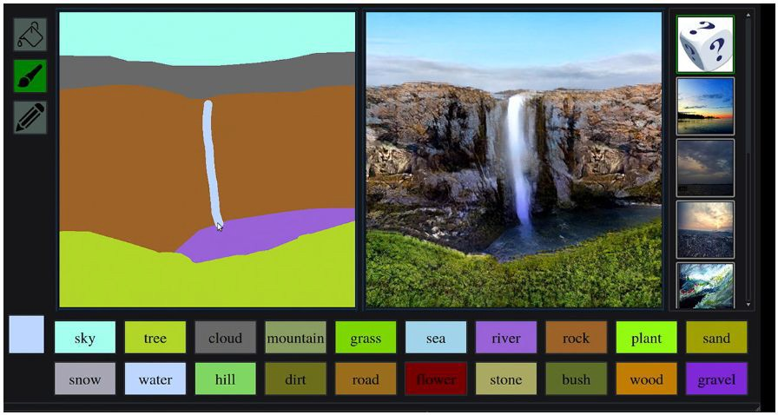
Interactive image generation

Slide 58
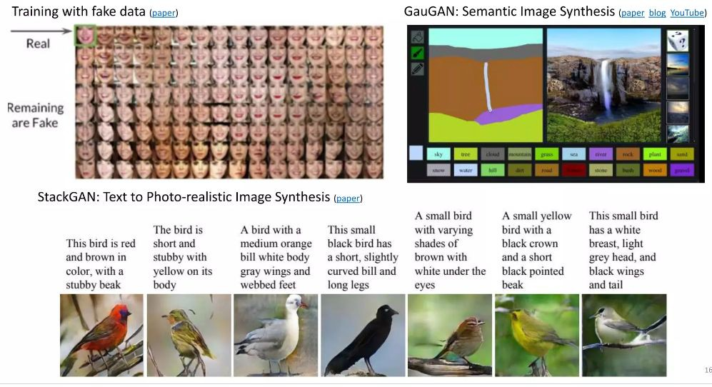
Data augmentation

Slide 59
QA
Thanks … Grazie … شكرا … Gracias … Merci … 谢谢 (Xièxiè)

